Slide 1
CytoAutoClustur A Study of Mass Cytometry in Cells
- Anup V Mensinkai

Slide 2
Table of Contents
01
Project Overview
02
Selecting the Right Dataset
03
Challenges and solutions
04
Methodology
05
Visualizing
06
Implementation
07
Results
08
Gradio Interface

Slide 3
Project Overview
CytoAutoCluster is an advanced solution for clustering cells based on unique characteristics. Using semi-supervised learning, it enhances clustering accuracy and computational efficiency, providing valuable insights into cellular data.
Key Features:
Semi-Supervised Learning: Leverages both labelled and unlabelled data to enhance clustering accuracy.
Efficient Cell Grouping: Segments cells into distinct clusters based on nuanced features.
Optimized for Performance: Handles large datasets with speed and precision.
Interpretability: Visualizes and explains cluster distributions clearly.
Scalability: Manages large, complex datasets without compromising performance.
Photo by Pexels

Slide 4
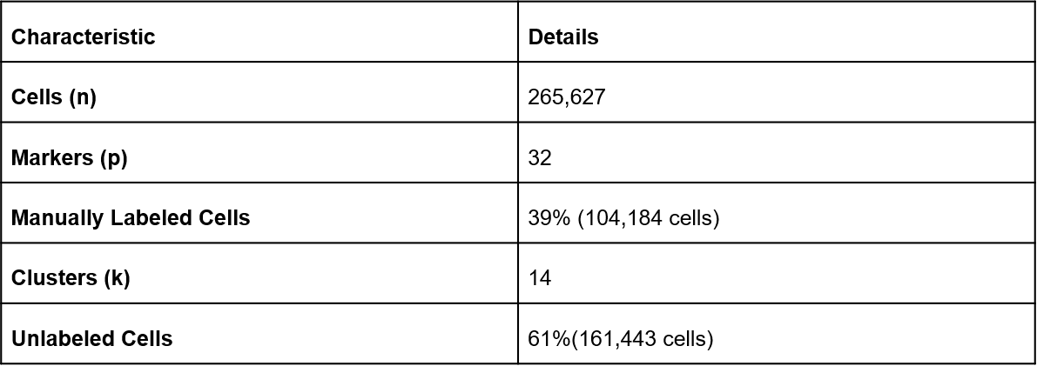
Dataset

Slide 5
Challenges and solutions
High Dimensionality: Complex data with 30+ markers per cell
Noise: Instrument variability and sample inconsistencies
Label Imbalance: Rare cell types are underrepresented
Solution Strategy: Semi-supervised learning, feature extraction, and robust preprocessing.

Slide 6
Methodology
Preprocessing:
Data normalization and exploratory analysis
Handling partially labelled datasets
Clustering Techniques:
Autoencoder-based dimensionality reduction
t-SNE visualization for cluster identification

Slide 7
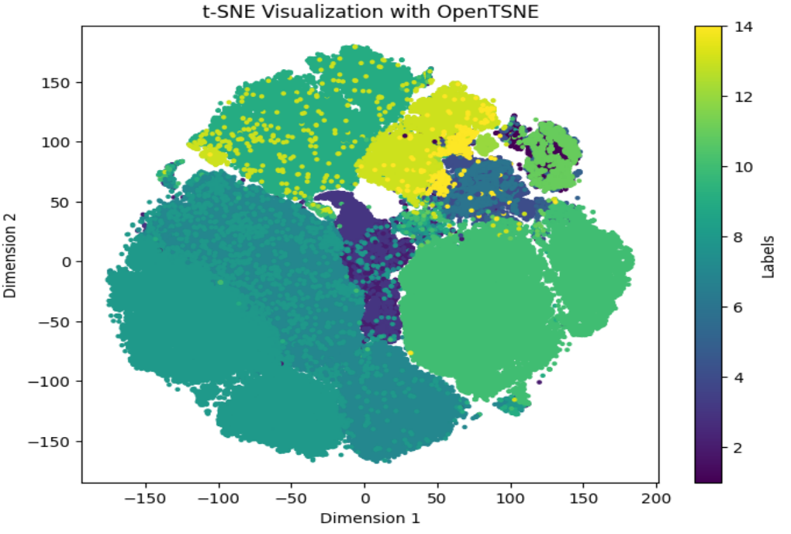
Visualizing Data
Correlation Matrix: Heatmap analysis for relationships between features. Skewness and Kurtosis Analysis: Understanding asymmetry and outlier impact. t-SNE Visualization: Dimensionality reduction for visualizing clusters and patterns.

Slide 8
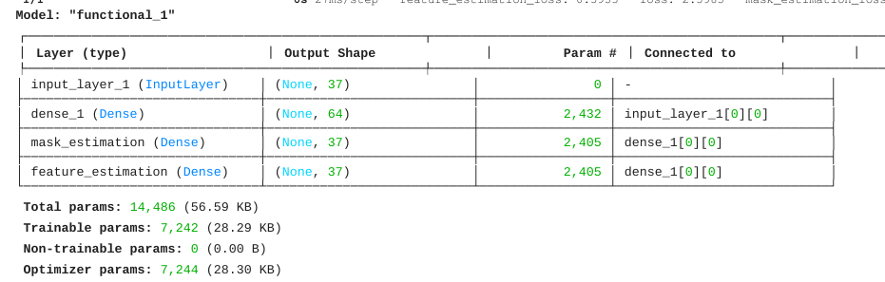
Implementation
Semi-Supervised Learning:
Self-supervised encoder for feature extraction
Supervised fine-tuning with logistic regression and XGBoost
Training Details:
Batch size, epochs, optimizers
Handling label imbalance with class weights

Slide 9
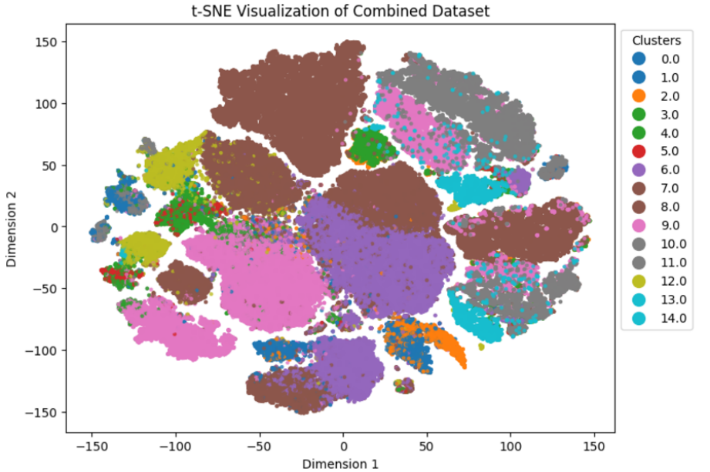
Results
Quantitative Metrics:
Logistic Regression Log Loss: 0.0649
XGBoost Log Loss: 0.0073
Self-Supervised Model Accuracy: 93.54%, AUROC: 99.09%
Visual Insights:
t-SNE plot showcasing cluster separation

Slide 10
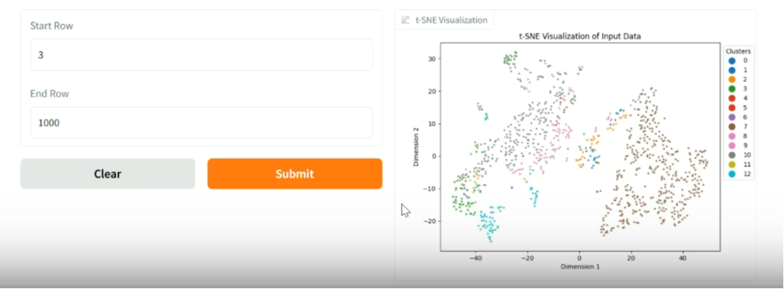
Gradio Interface for User Interaction
Features:
Visualize data subsets with t-SNE
Predict cell types dynamically
Key Functions:
Encodes unlabeled data
Generates predictions and visualizations

Slide 11
Thank You

